Slide 1
Gleaning food safety

Slide 2
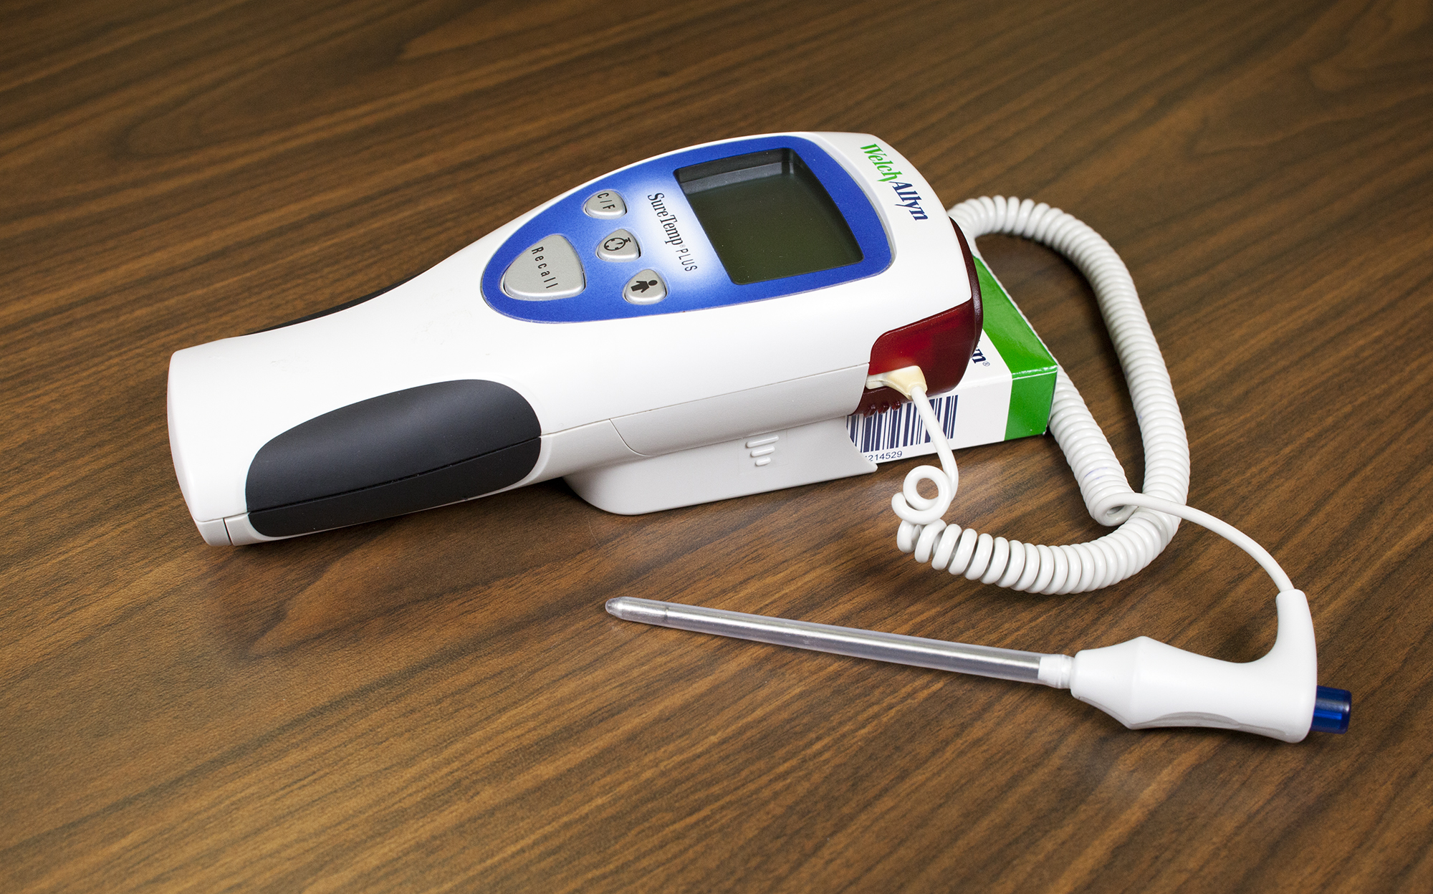
Don’t glean while sick
Whether a stomach problem or an upper respiratory illness, keep others well.
This Photo by Unknown Author is licensed under CC BY
This Photo by Unknown Author is licensed under CC BY-SA

Slide 3
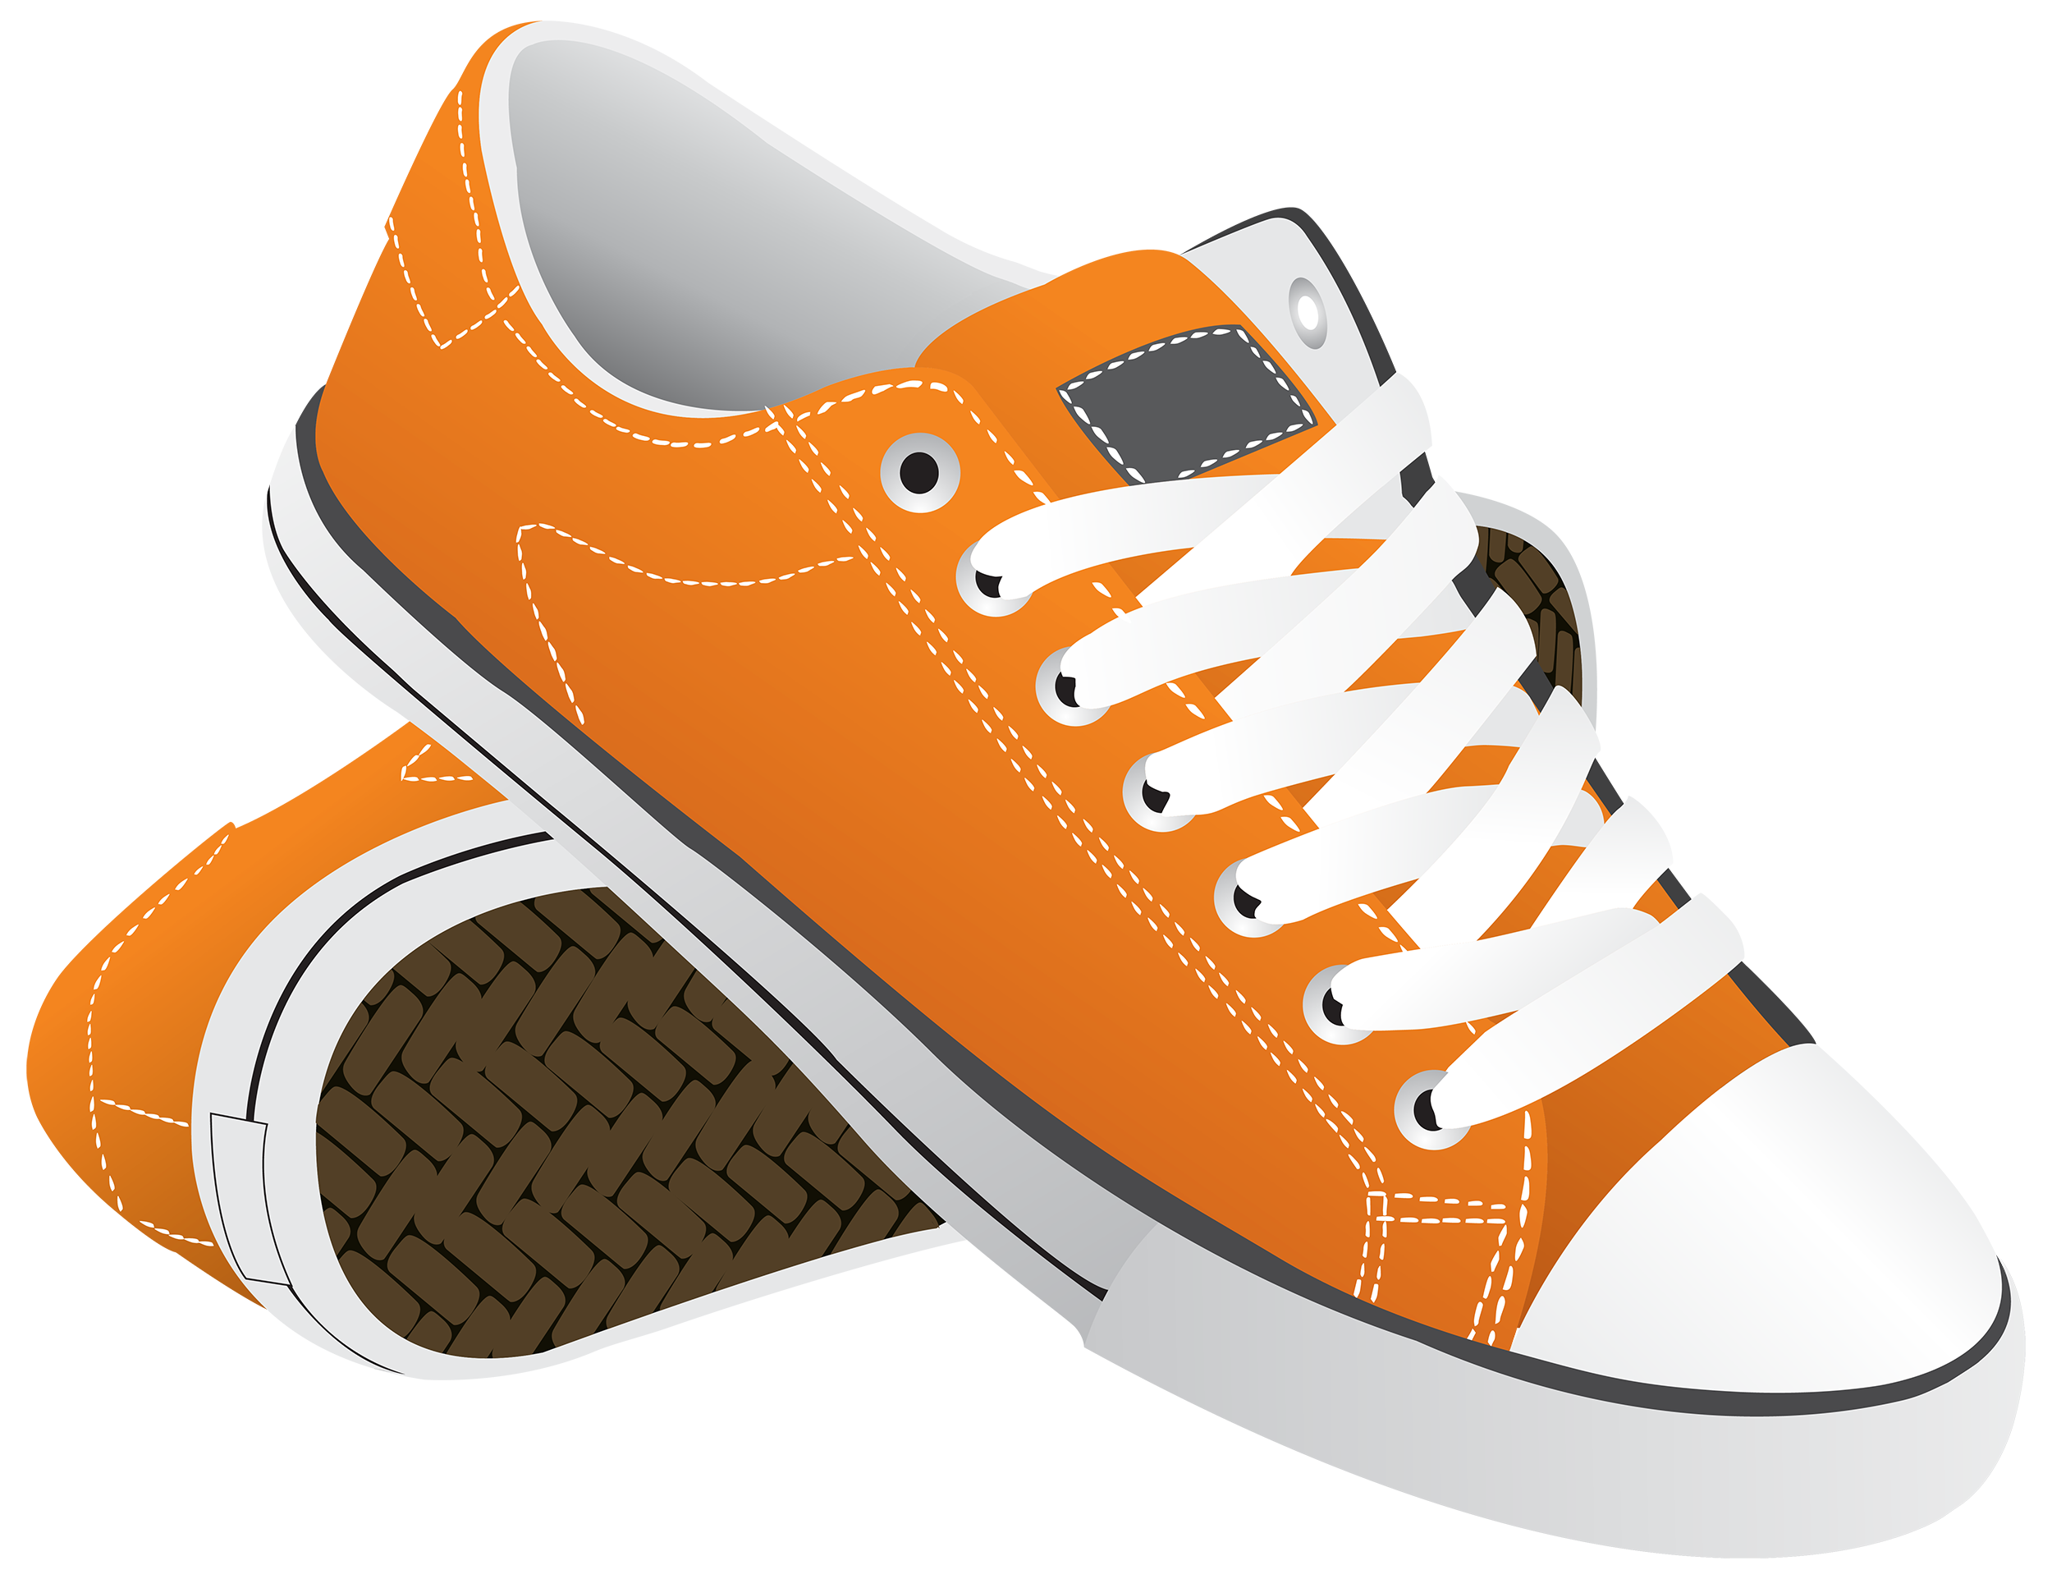
Clothing
Wear clean clothes
Wear clean shoes
Wear closed toed shoes
Wear clean gloves (if used)
Where clothes that will not
Get caught on fences, plants,
Or equipment
This Photo by Unknown Author is licensed under CC BY-NC

Slide 4
Wash your hands
Wash your hands before gleaning (even if using gloves)
Wash your hands when changing from one product to another
Wash your hands at 4 hours of gleaning even if it is the same product
Wash your hands after gleaning
Wash your hands after touching an animal, pet or farm animal
This Photo by Unknown Author is licensed under CC BY-NC-ND

Slide 5
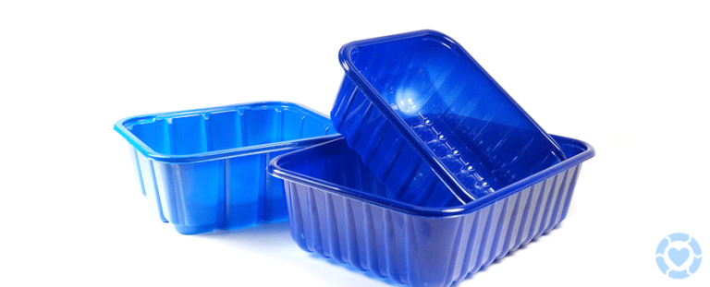
Keep Things Clean
Keep cleaning areas clean
Make sure the packing bins are cleaned and sanitized
Transport vehicles need to be clean and free of dirt and debris
This Photo by Unknown Author is licensed under CC BY-SA-NC

Slide 6
Animals
Leave pets at home
Avoid animals at the property
If you pet or otherwise touch an animal, wash your hands before returning to gleaning
This Photo by Unknown Author is licensed under CC BY-SA-NC

Slide 7
Know:
What bathroom to use
Where the designated food and beverage area is
This Photo by Unknown Author is licensed under CC BY-SA-NC

Slide 8
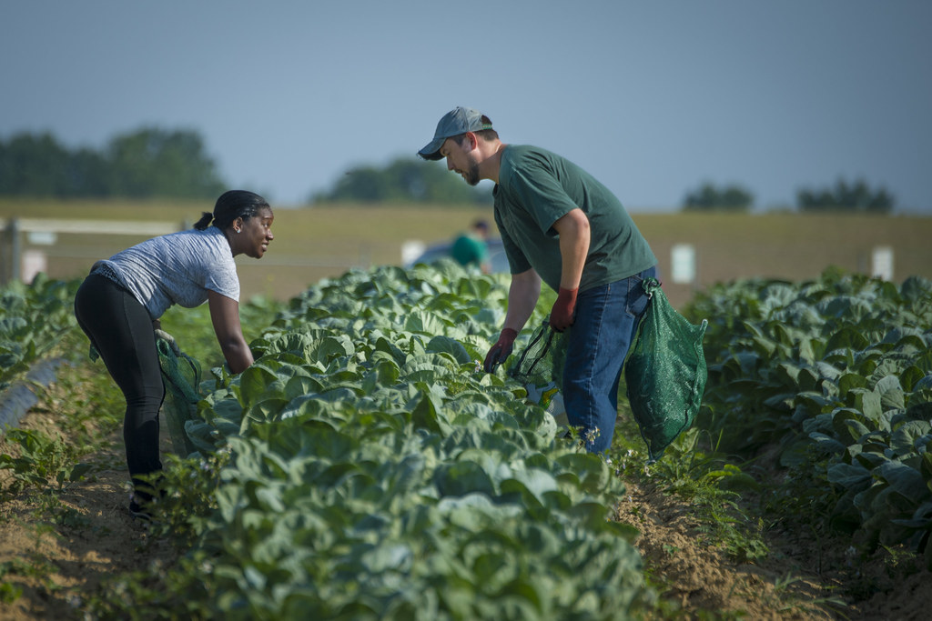
While gleaning
Look for animal intrusion
Don’t glean damaged or dropped produce
Keep harvest bins off the ground
Follow color coding
If dropped, throw it away

Slide 9
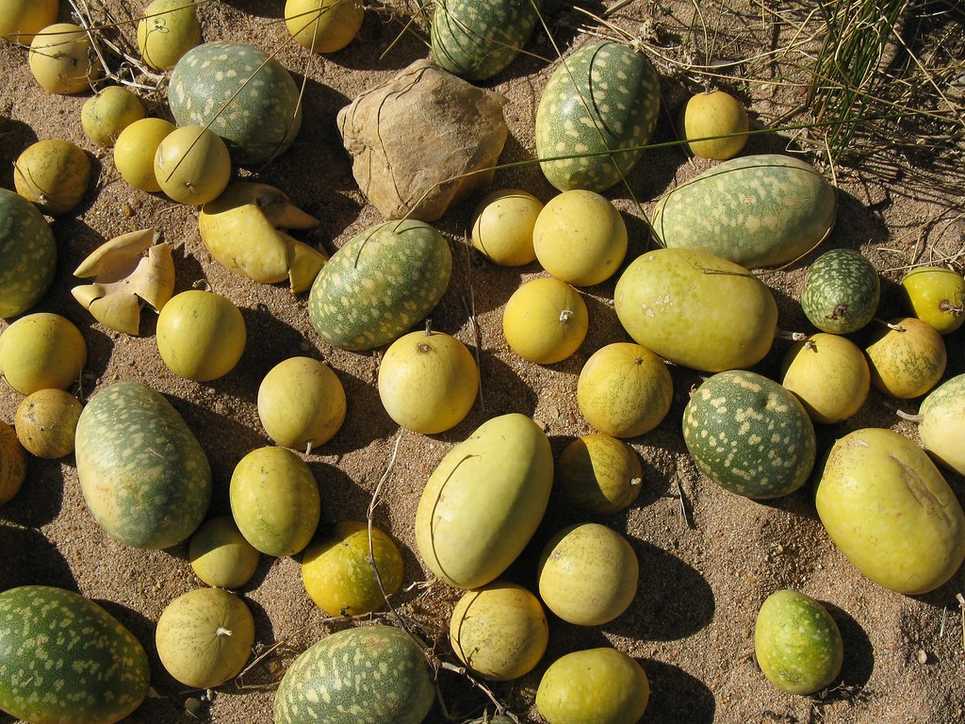
Gleaning Continued
Produce grown on or in the ground is fine to harvest as long as there is no damage to the produce or signs of animal intrusion
This Photo by Unknown Author is licensed under CC BY-SA-NC
This Photo by Unknown Author is licensed under CC BY-SA-NC

Slide 10
Gleaning Continued
Produce with dirt on it, such as root vegetables, must be packed away from other produce (i.e. lettuce or fruits).

Slide 11
Equipment
Produce bins must never be used to store anything else
Containers that held chemical must never be used as produce bins
This Photo by Unknown Author is licensed under CC BY-ND

